Slide 1
Optimizing the Nutrition Care Pathway
Dim3 Products Financial Outcome / Presentation for Baxter

Slide 2
The Dim3 global products architecture :
Majority of Diseases are managed in the same way
DETECTION PHASE :
Patient interrogation
Diagnostic
Scorings
TREATMENT
Drugs
Medical Devices
Other procedures
Patient awereness
Follow-up
Adjustments
Remission status
Relapse/Chronic risk management
Patient interrogation
Diagnostic
Scorings
DIM3 products scope
All data available
Anytime
Anywhere
AND
Always actionnable as data
In All patients care pathway
Architecture Adaptable to different diseases using same management pattern

Slide 3
The Dim3 global products architecture :
DATA POOLS
EHR
Nursing reports
Doctors reports
Lab results
Examination data
Images
Data of third parties packages used in hospital
DIM3 TOOLS
SCORING TOOL More than 280 scorings in medicine
SCORSO
All Data aggregation disease focused
NUTROW
Missing data from Medical devices collection
FEEDIM
CONNECTORS
Data structured easing DataSciences cost and speed
R&Ds
Scientific
Clinical
Algorithms
Correlations
Procedures
Economics
…
Data No structured to be used in DataSciences
Data structured

Slide 4
The Dim3 global products architecture : Nutrition
DATA POOLS
EHR
Nursing reports
Diet reports
Doctors reports
Lab results
Data of third parties packages used in hospital
Metavision
ICCA
Per OS food
DIM3 TOOLS
SCORSO
NRS2002, SGA …..
All Data aggregation Nutrition products to patient + Hydric balance …
NUTROW
Missing data from Feedin Pump
FEEDIM
CONNECTORS
Data structured easing DataSciences cost ,speed and decision process
R&Ds
Economics
Correlation
Clinical

Slide 5





Root Causes of Malnutrition
Poor Detection
Less than 60% Compliance^{1,2}
Patients at malnutrition risk are not detected or not detected soon enough
Patients don’t receive what they have been prescribed. Very few know the issue
Lack of Knowledge
Multi-step, Disconnected Care
Professionals lack knowledge and sometimes interest in nutrition, resulting in non-optimal practices
Multiple in-hospital transitions, lack of coordination between hospital and home and the trend toward shorter LOS intensifies an issue that is already ill-addressed
1. https://pubmed.ncbi.nlm.nih.gov/19572118/
2. https://pubmed.ncbi.nlm.nih.gov/31684024/

Slide 6

The DRGs
Medicare DRG (CMS-DRG & MS-DRG)
Refined DRGs (R-DRG)
All Patient DRGs (AP-DRG)
Severity DRGs (S-DRG)
All Patient, Severity-Adjusted DRGs (APS-DRG)
All Patient Refined DRGs (APR-DRG)
International-Refined DRGs (IR-DRG)
Choice of DRG is a “political” choice for
- Patient finances
- Revenues of companies/institutions
- Cost for the government
The payer determines which payment methodology they would like to use for reimbursement.
Medicare uses Medicare Severity-Diagnostic Related Groups (MS-DRG), as do many private payers, but some may choose to use a modified reimbursement payment methodology.
The All Patient Refined DRG (APR-DRG) system was developed by 3M™,

Slide 7

The All Patient Refined DRG (APR-DRG) system was developed by 3M™
With solutions in 25 countries and 10,000 hospitals worldwide, 3M Health Information Systems is the global leader in coding, patient classification and grouping, performance management software and consulting services.
In Belgium and other countries or region, 3M has been chosen by authorities .

Slide 8

Hospitals financing in Belgium
Belgium State Financing trough reimbursement
Incentive Programs from the state
Doctors billings
Pharmacy & Meddev procedures
Area where Dim3 has a positive impact

Slide 9





Reimbursment pathway Belgium
DRG with Severity Defined by State
Step 1
ENCODING DEPARTMENT OF HOSPITAL
Medical Records of the patient
Reports Doctors
2
3
SOFTWARE 3M
INAMI
RCM/RHM/
Minimal Clinical Summary
Codes ICD 10
Severity (SOI)
Death probability
+
DMN
Request of Reimbursment
Payed around 2 years after
NOT REPORTED
NOT REIMBURSED
+
NO RETURN
Principal Diagnostic
Electronic health records
Nutrow
Or Scorso
Secondary Diagnostics
Medical procedures
SOI
ROM
MND
Severity of diseases
Death Probability
Mean National Duration Days
Technically feasible but …

Slide 10
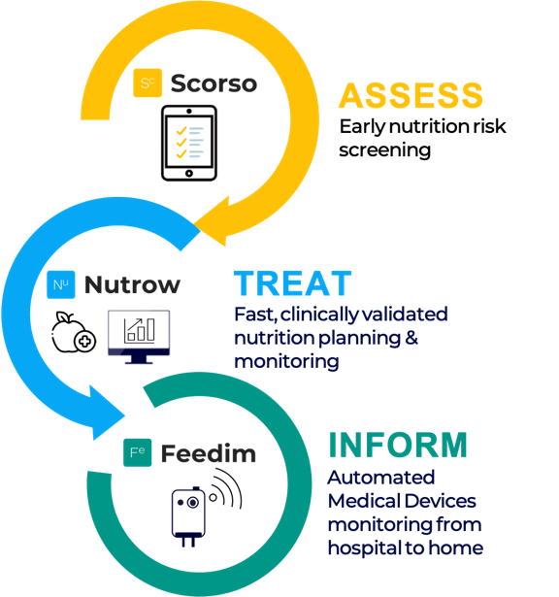
Malnutrition and Reimbursement
FACTS – Belgium and elsewhere
30-50% of hospitalized patients are at risk of Denutrition
33% of hospitalized patients are undernourished
35% of patients are undernourished at discharge

Slide 11
Malnutrition impact on Reimbursement :
Impacting Severity
+ OBESITY = 1 to 2 points
ICD 10 Malnutrition/obesity : Severity points
E40 / E41 / E42 = Kwashuirkor/Marasmus …
E43 = Malnutrition Severe
E440 = Malnutrition Moderate
E441 = Malnutrition Light
E46 = Malnutrition unspecified
4 points
4 Points
3 Points
2 Points
3 Points
Attention Point : GLIM different classification

Slide 12
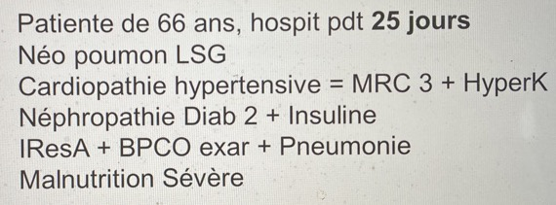
ROI de la plateforme DIM3 : DATA 1 Erasme
Source Mme Farine chef de service dietetique / congrès de diététique thérapeutique Erasme du 27/05
AUTHORIZED DMN 2 DAYS
Perte DMN = 23 jours si diagnostic primaire RCM
Perte DMN = 21 jours si diagnostic primaire + secondaires RCM
Perte DMN = 15 jours Affinage des Sévérités et Mortalités
Perte DMN = 0 jours en incluant Malnutrition sévère
Analyse RCM ERASME (Référence Nationale en Nutrition Clinique)
51 patients au hasard
16 Dénutris = 31%. / Denutrition modérée 4 / Denutrition severe 12
Réanalyse RCM
= 10 % des hospitalizations gagnent 1 point de sévérité si on inclut la malnutrition en mode digital (Dim3)
2 patients passent de 2 à 3 de sévérité / 4% des hospitalisation
3 patients passent de 3 à 4 de sévérité / 6% des hospitalisations

Slide 13
Infos Slides
Dim3 Products Financial Outcome

Slide 14
ROI de la plateforme DIM3 : Data 2
Analyse RCM CHC: Source Francoise Martin Coordinatrice nutritionnelle CHC
sur 6O patients codés 43 journées récupérées = 0,72 jours/Hospi
Analyse CHU Namur : Virginie Vanesse, Chef de service Alimentation Diététique
sur 47 patients codés 20 dossiers augmentent la sévérité = 43% des dossiers
L’ajout de données : laboratoires/malnutrition impacte le codage de 109 jours sur 47 dossiers = 2,3 jours/Hospi
En Moyenne une journée = 600€ de remboursement (Source Inami)

Slide 15
General hospitals are required to provide the SPF Public Health with a Minimum Clinical Summary (MCS/RCM). This document summarizes the care pathway of each patient within the institution.
A standardized and concise summary of the medical file, the RCM also contains information about the hospital, the medical department concerned, the patient's data (age, sex, etc.), the length of stay, the diagnosis and the various procedures applied to the patient, as well as data about the care provided by the caregivers.
These data are summarized and coded using an international classification system, International Classification of Diseases-10-Clinical Modifications
.The data are then transmitted every six months to the SPF Public Health via an online application. "This information is grouped with that of all other hospitals in the country to establish a national case-mix table determining the average length of stay per pathology.
The justification for the stay is established on the basis of this table and the co-morbidity factors that accompany the care episode.

